Slide 1
Requirements and SDLC

Slide 2
Milestones in the RE process

Slide 3
The project scheduling process

Slide 4
Scheduling problems
Estimating the difficulty of problems and hence the cost of developing a solution is hard.
Productivity is not proportional to the number of people working on a task.
Adding people to a late project makes it later because of communication overheads.
The unexpected always happens. Always allow contingency in planning.

Slide 5
The Cost of Change
An AT&T study indicated that, on average,
Business Rules change at
the rate of 8% per month.

Slide 6
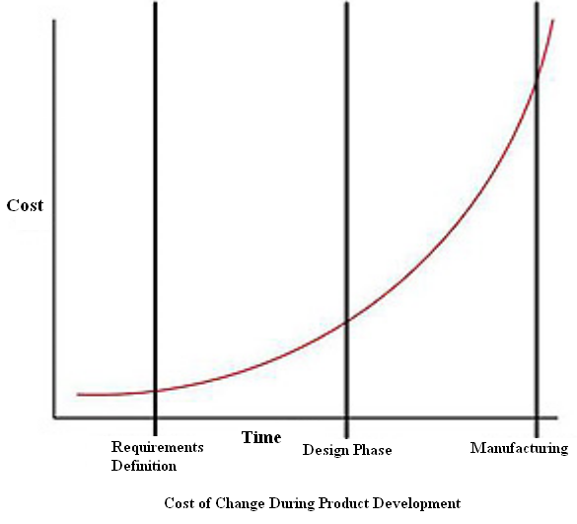
Requirement Change vs. Cost

Slide 7
Requirements engineering
The process of establishing the services that the customer requires from a system and the constraints under which it operates and is developed.
The requirements themselves are the descriptions of the system services and constraints that are generated during the requirements engineering process.

Slide 8
What is a requirement?
It may range from a high-level abstract statement of a service or of a system constraint to a detailed mathematical functional specification.
This is inevitable as requirements may serve a dual function
May be the basis for a bid for a contract - therefore must be open to interpretation;
May be the basis for the contract itself - therefore must be defined in detail;
Both these statements may be called requirements.

Slide 9
Requirements abstraction (Davis)

Slide 10
Types of requirement
User requirements
Statements in natural language plus diagrams of the services the system provides and its operational constraints. Written for customers.
System requirements
A structured document setting out detailed descriptions of the system’s functions, services and operational constraints. Defines what should be implemented so may be part of a contract between client and contractor.

Slide 11
Definitions and specifications

Slide 12
Requirements readers

Slide 13
Non-functional requirement types

Slide 14
Non-functional requirements examples
Product requirement
8.1 The user interface for LIBSYS shall be implemented as simple HTML without frames or Java applets.
Organisational requirement
9.3.2 The system development process and deliverable documents shall conform to the process and deliverables defined in XYZCo-SP-STAN-95.
External requirement
7.6.5 The system shall not disclose any personal information about customers apart from their name and reference number to the operators of the system.

Slide 15
Goals and requirements
Non-functional requirements may be very difficult to state precisely and imprecise requirements may be difficult to verify.
Goal
A general intention of the user such as ease of use.
Verifiable non-functional requirement
A statement using some measure that can be objectively tested.
Goals are helpful to developers as they convey the intentions of the system users.

Slide 16
Examples
A system goal
The system should be easy to use by experienced controllers and should be organised in such a way that user errors are minimised.
A verifiable non-functional requirement
Experienced controllers shall be able to use all the system functions after a total of two hours training. After this training, the average number of errors made by experienced users shall not exceed two per day.

Slide 17
Requirements measures

Slide 18
Risks and risk types

Slide 19
Risk analysis (i)

Slide 20
Risk analysis (ii)

Slide 21
Risk management strategies (i)

Slide 22
Risk management strategies (ii)

Slide 23
Risk indicators

Slide 24
Goal
Justification to Buisiness
Interviewing Client
Influence on Project
Benefiets
Strategy Alignment
Implementation Cost
Yearly Maintenance Cost
Risk
Schedule
Team Morale
Cost

Slide 25
Requirements
Design
Implementation
Verification
Maintenance

